Slide 1
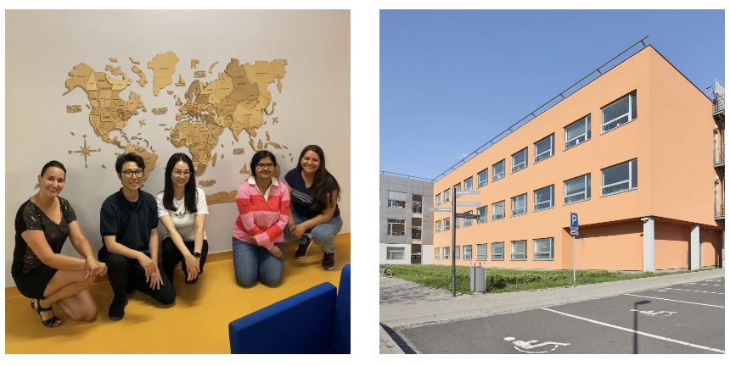
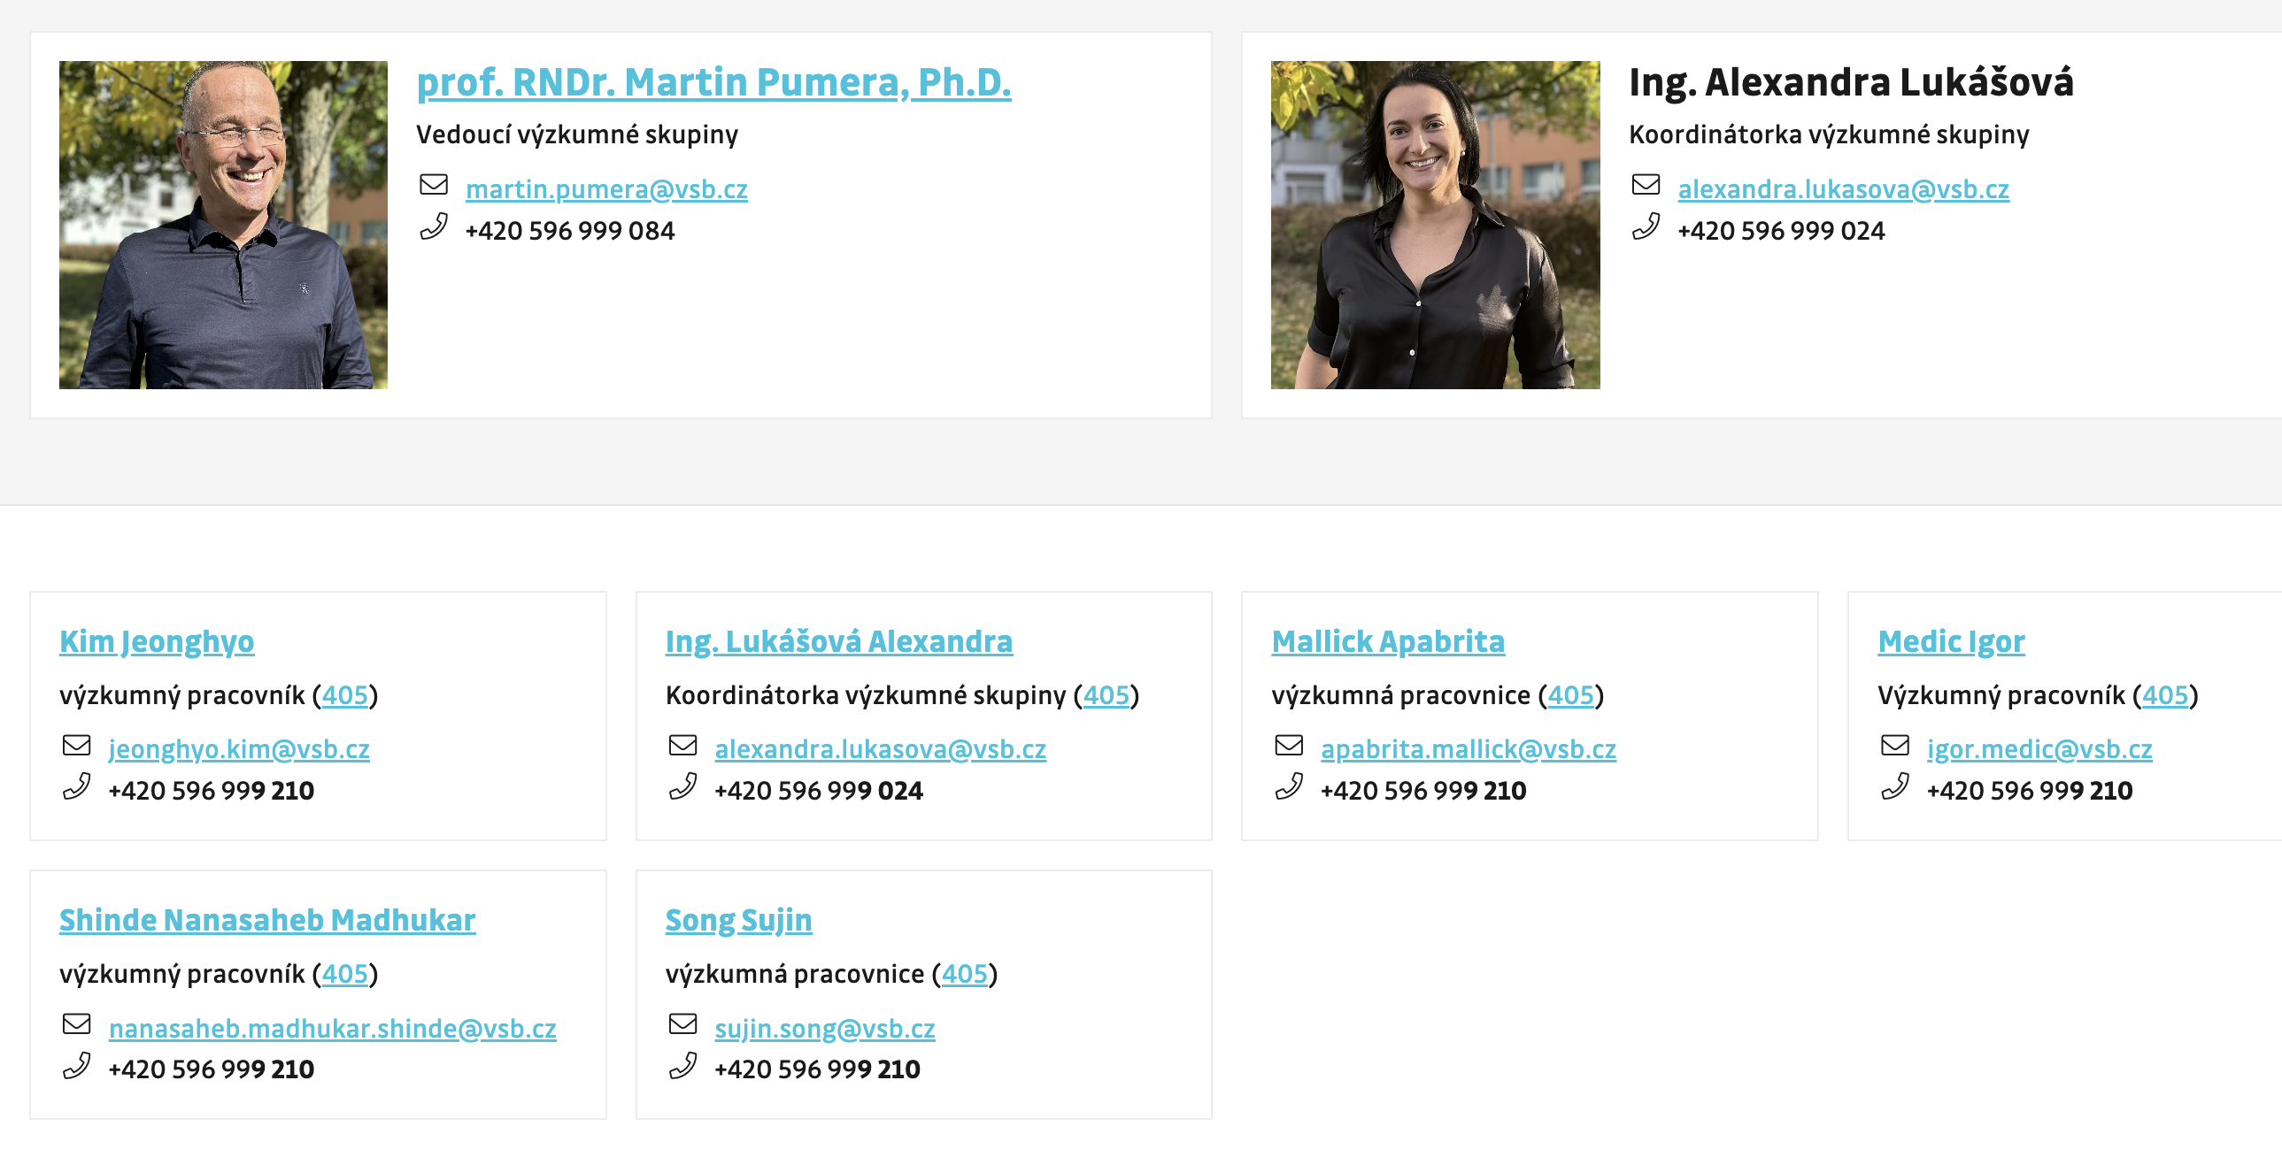
Advanced Nanorobots & Multiscale Robotics Lab
nanorobots.vsb.cz
Prof. Martin Pumera

Slide 2
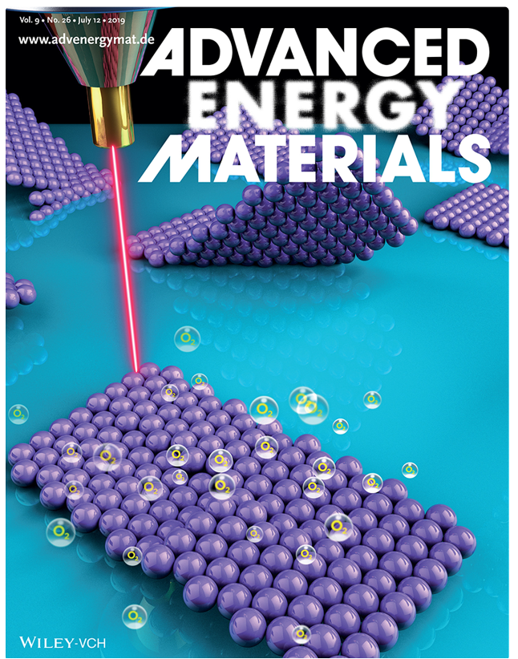
Technologies: flexible electronics, energy storage, nanorobotics, Applications: energy, environmental remediation, biomedicine
Future Energy & Sensing Wearable sensors and biosensors
Supercapacitors: 2D mater, quantum mater, 3D printing
Batteries: Sodium, Zinc air, solid state batteries
Nano & Microrobotics Biomedical applications: biofilm removal, cancer cell treatment, stomach
Environmental app: Removal of pesticides, nerve agents, explosives, microplastics

Slide 3
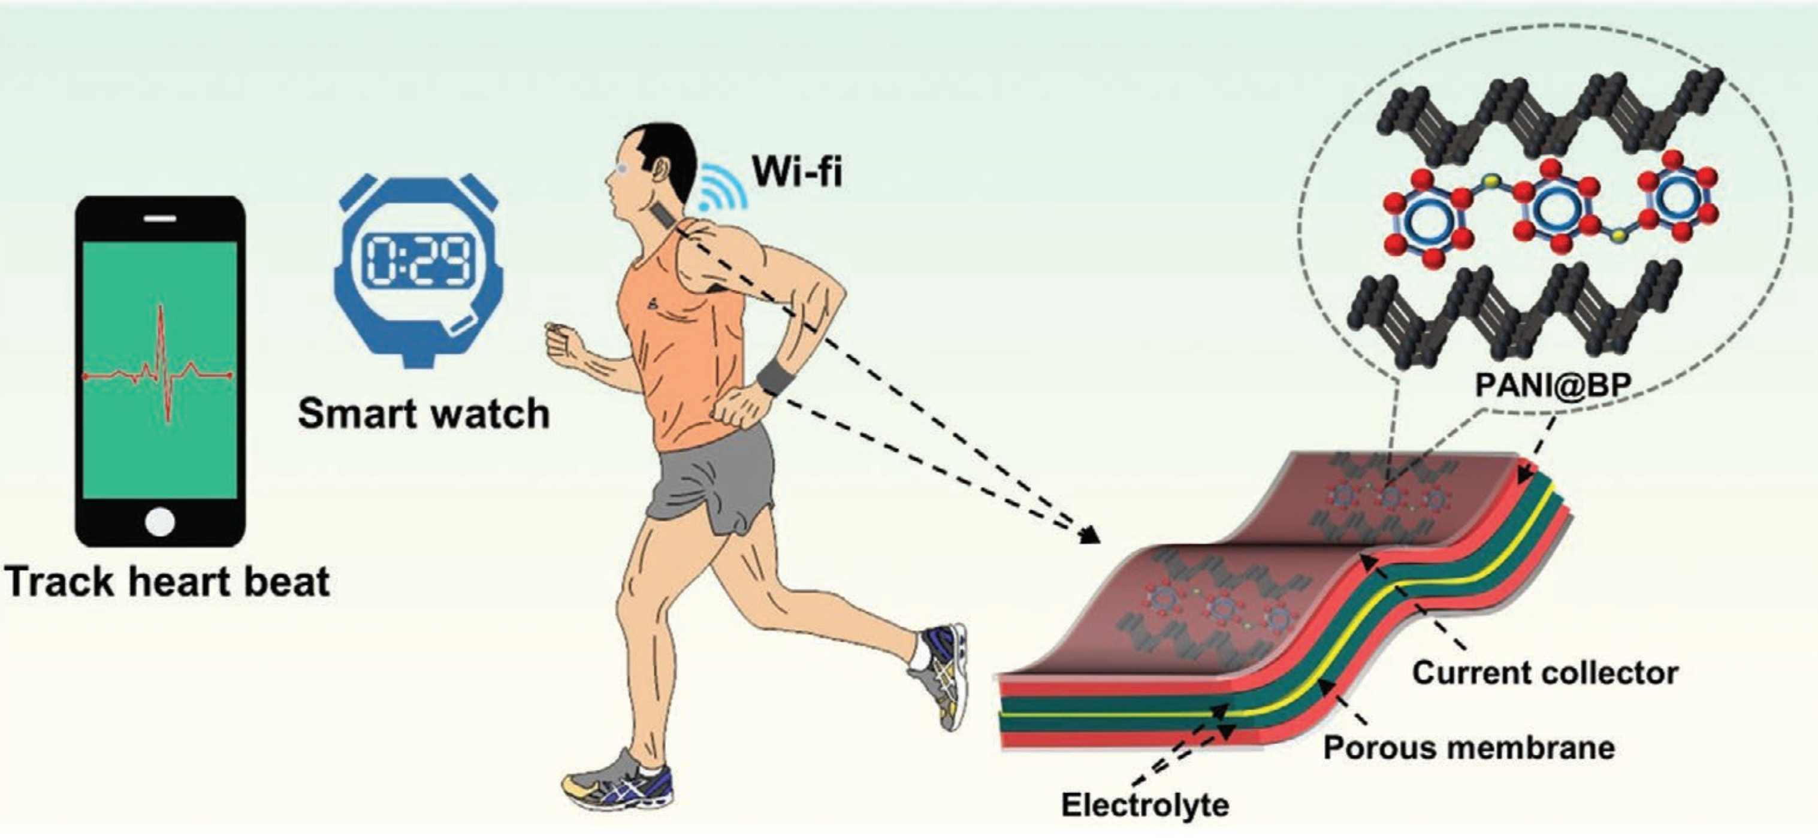
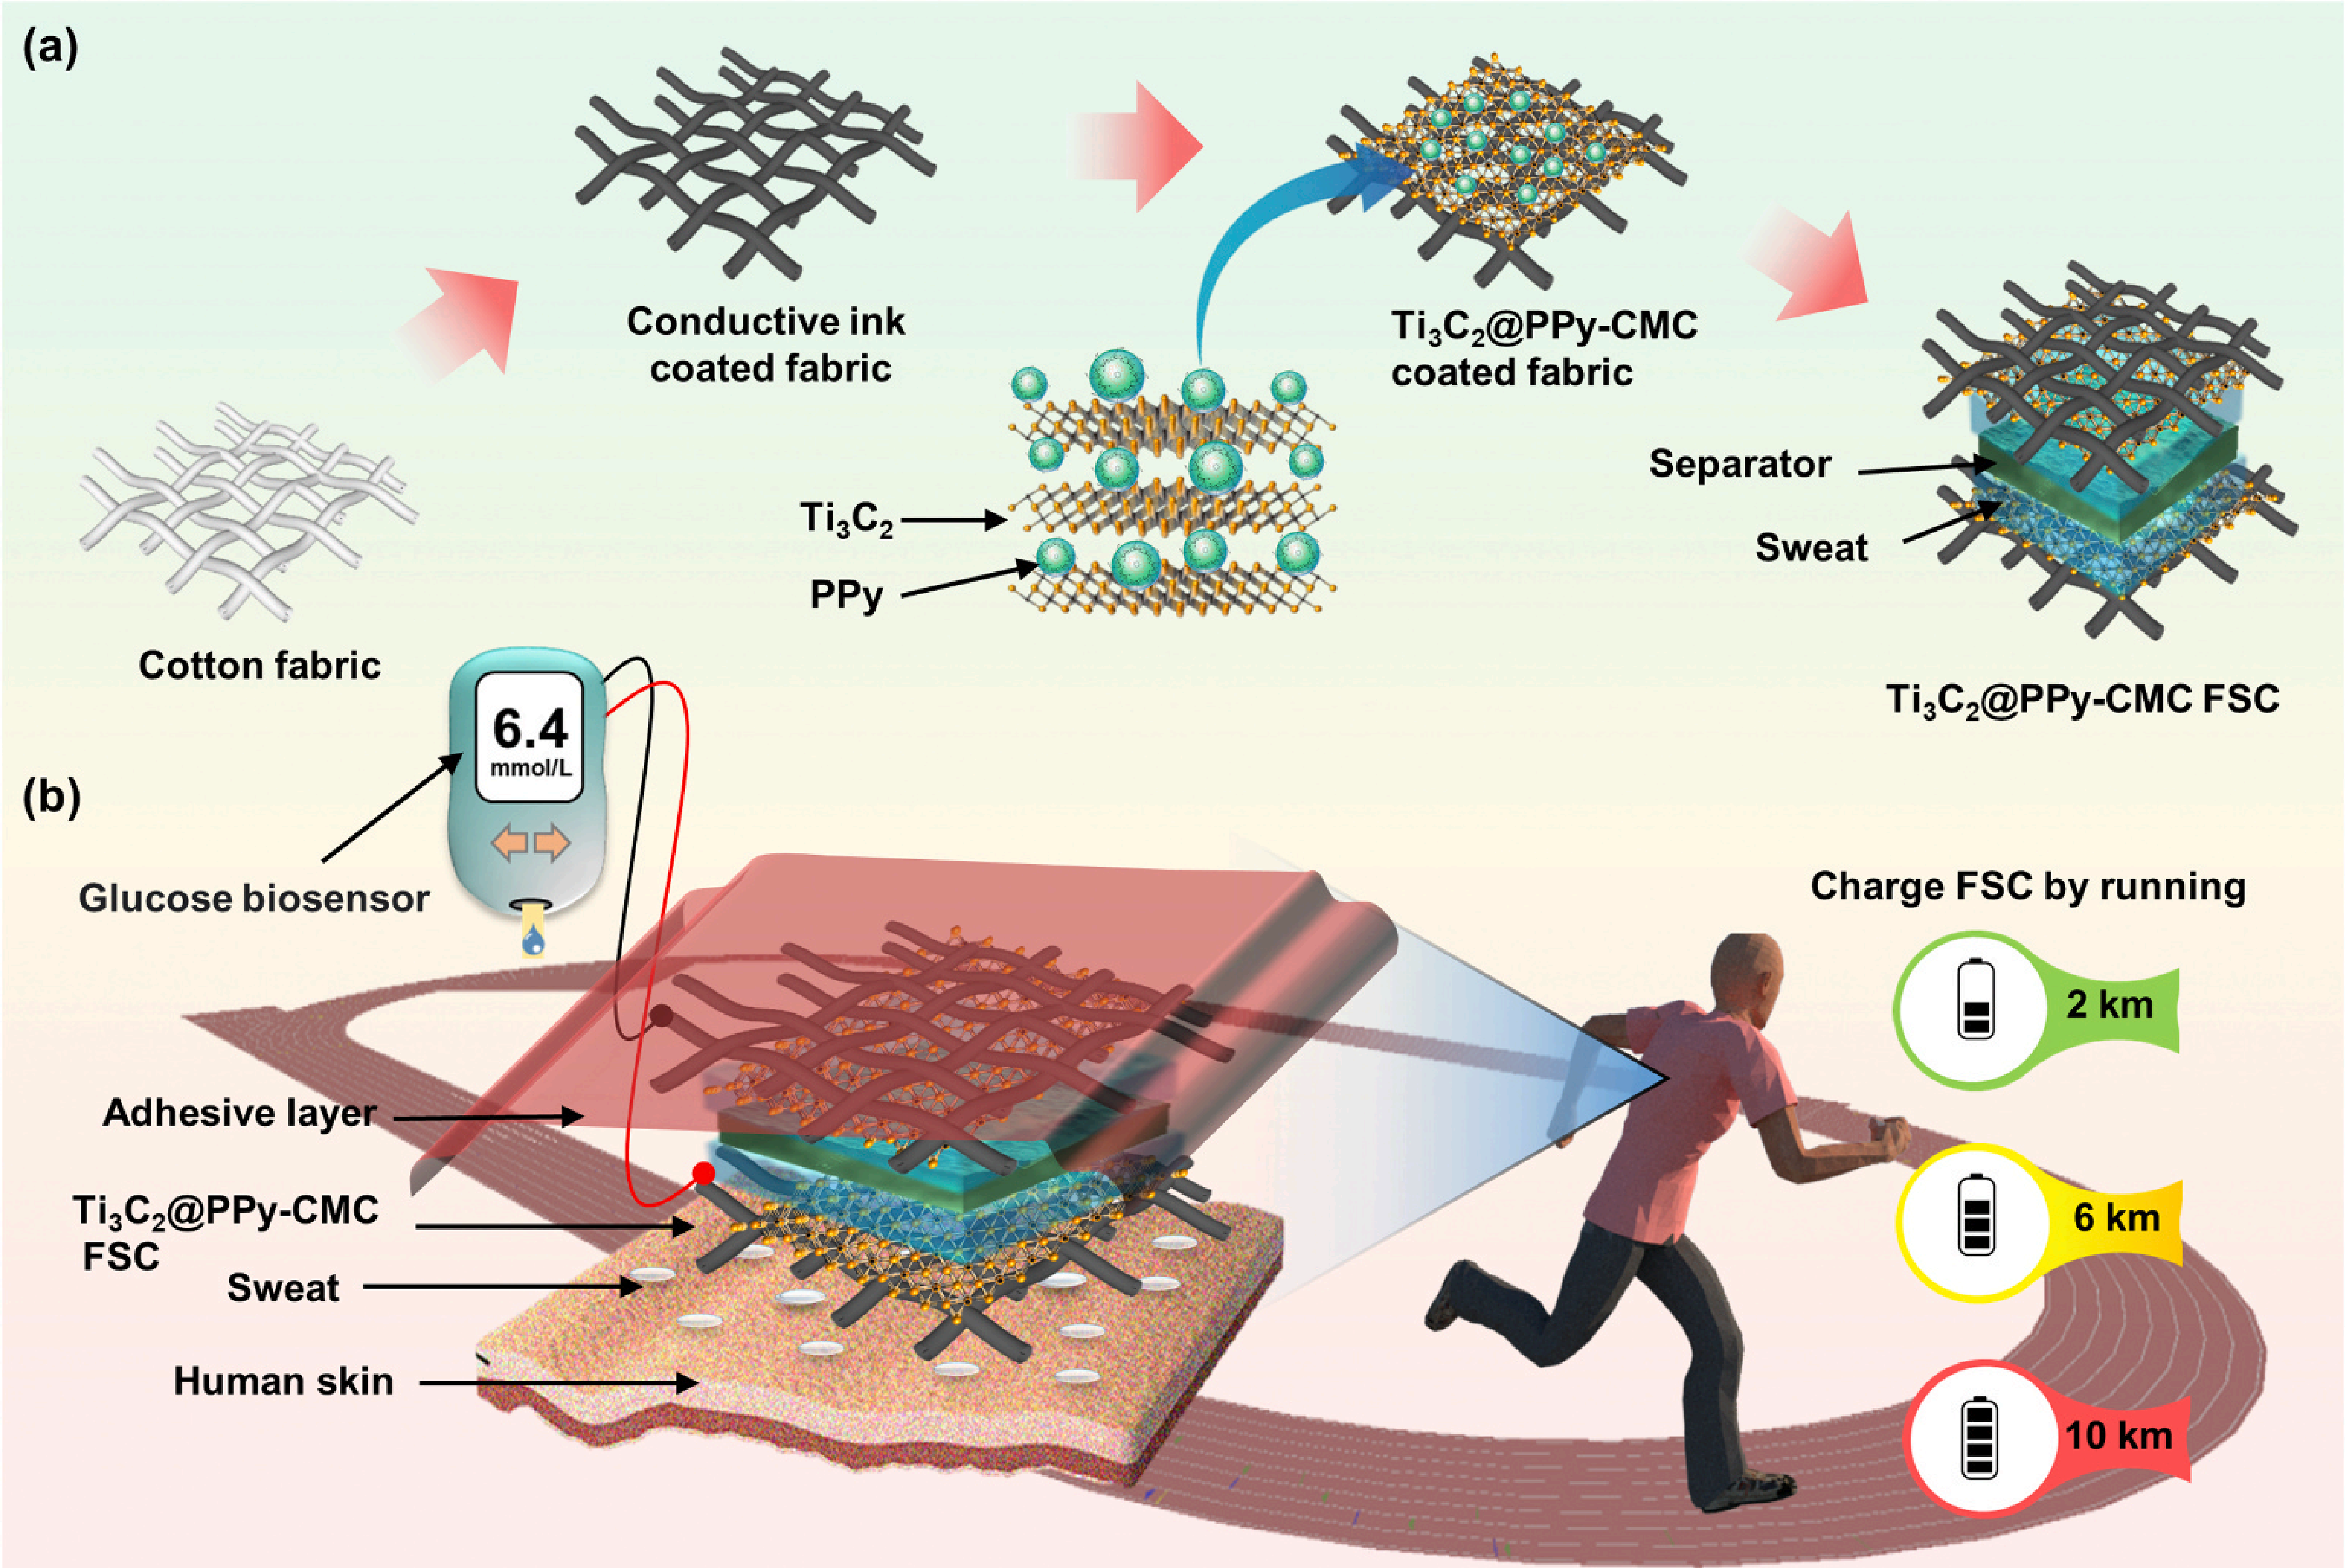
Integrated Real-Time Biomonitoring Devices Power Source and Sensors

Slide 4
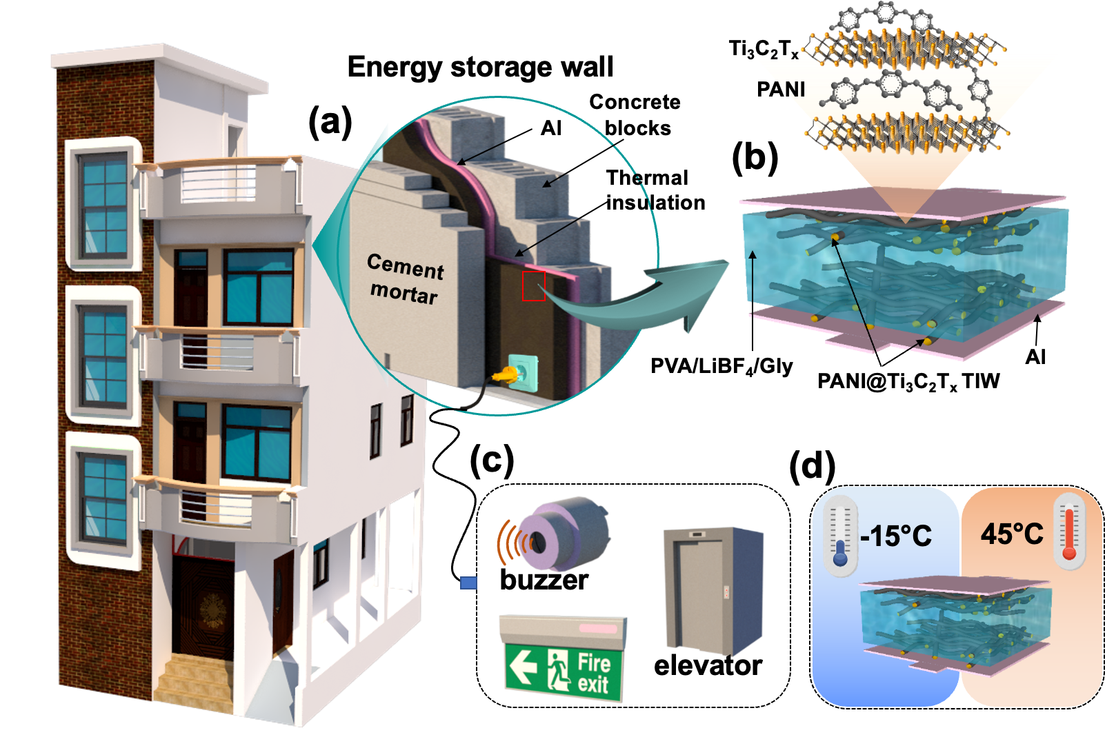
Energy Storage: Buildings & Transportation

Slide 5
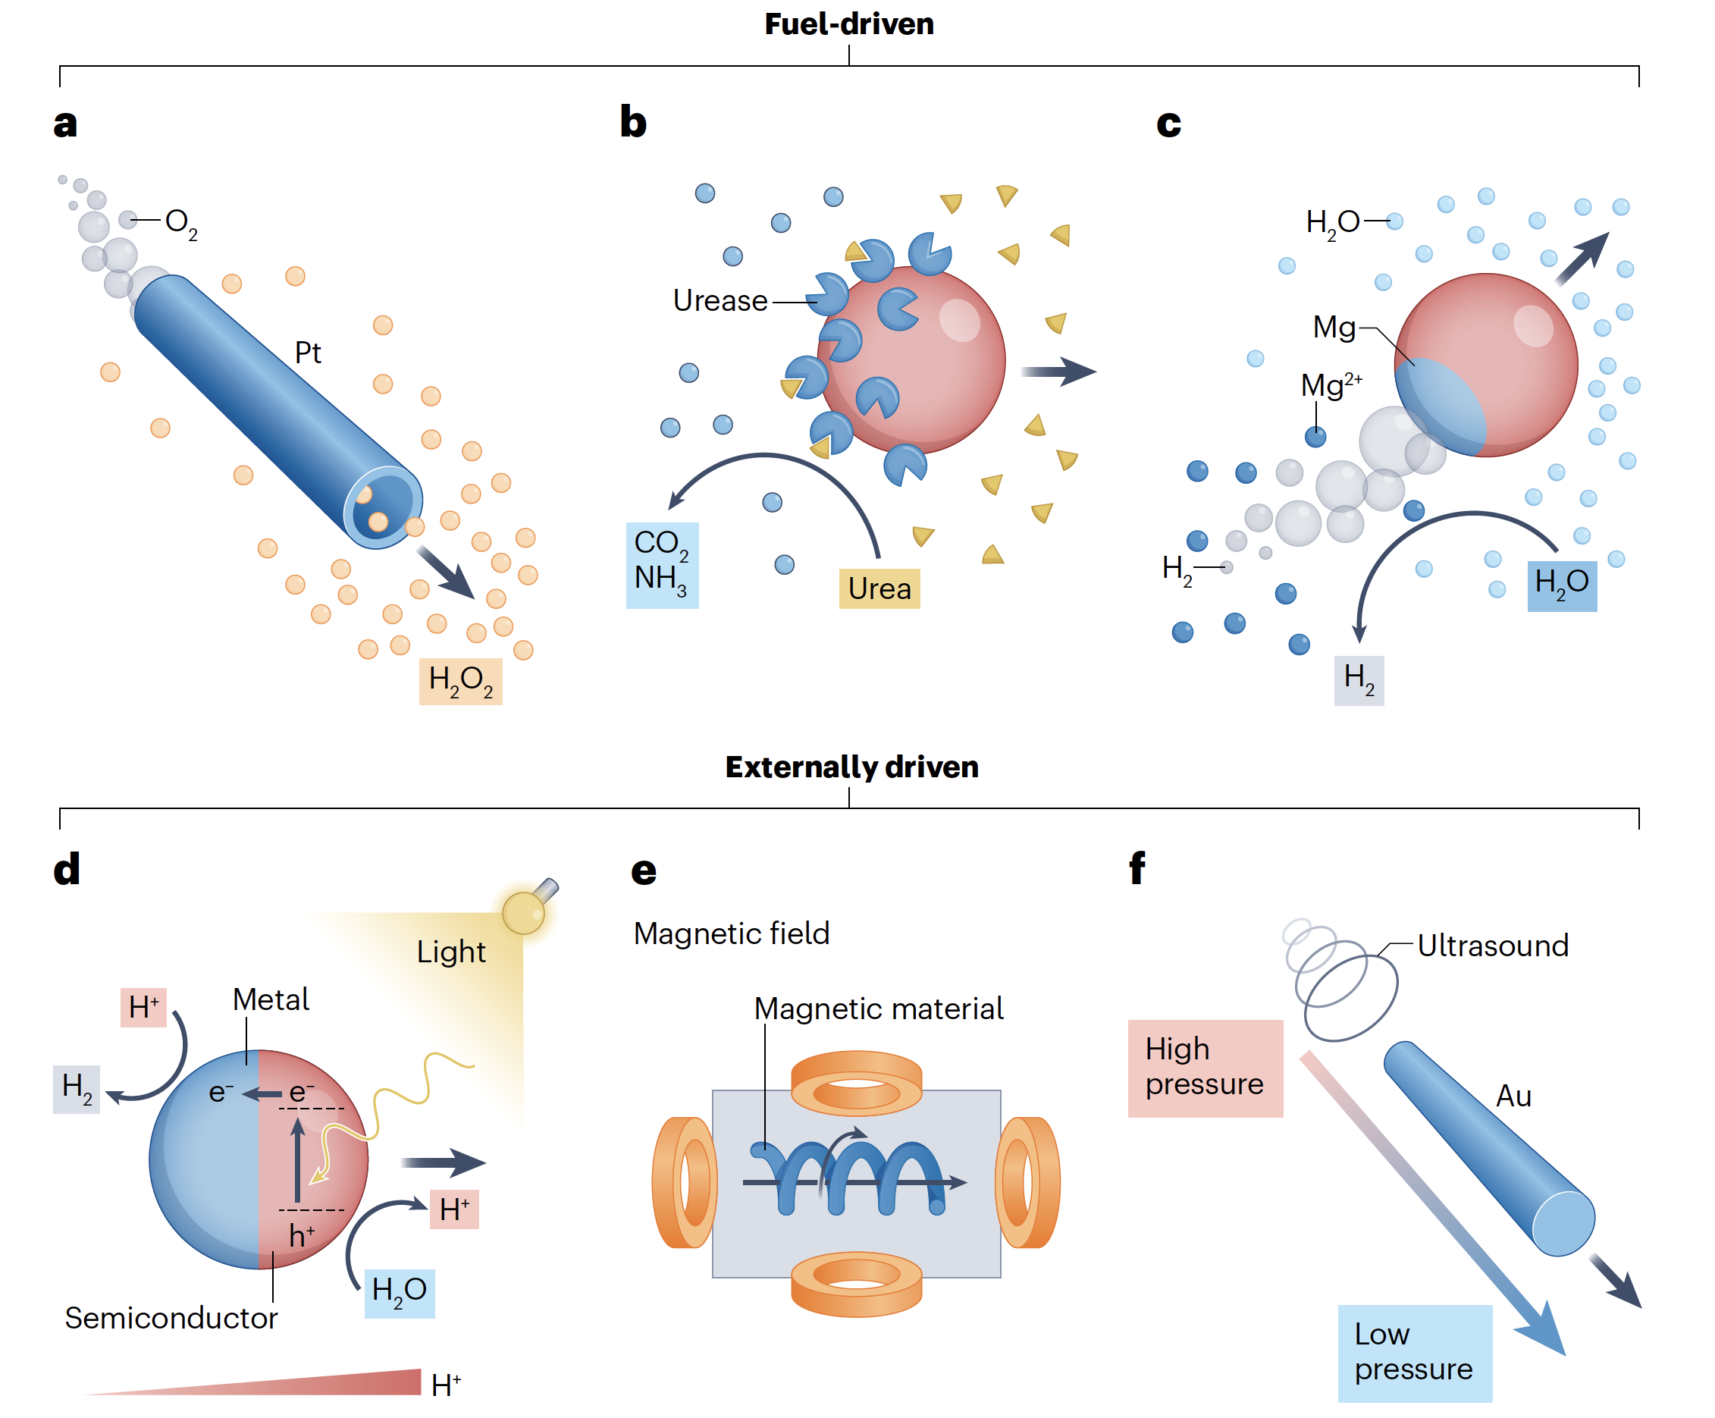
Micro & Nanorobots

Slide 6
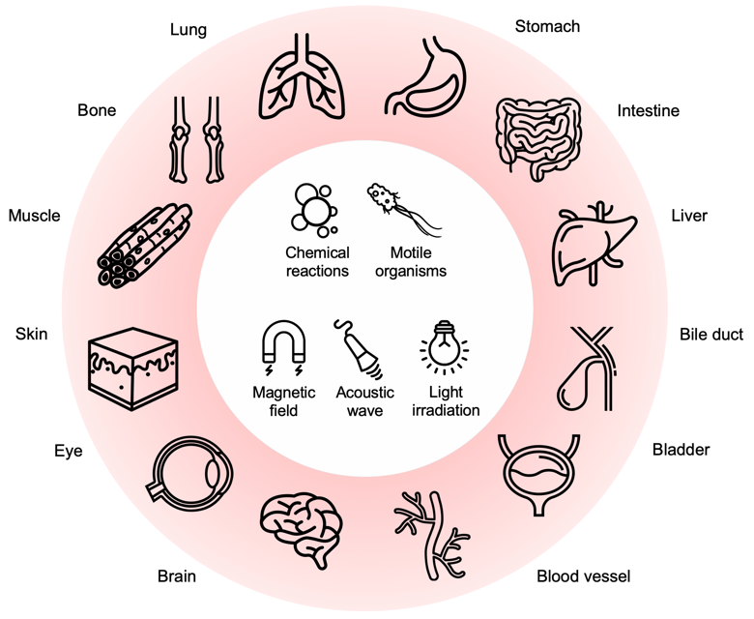
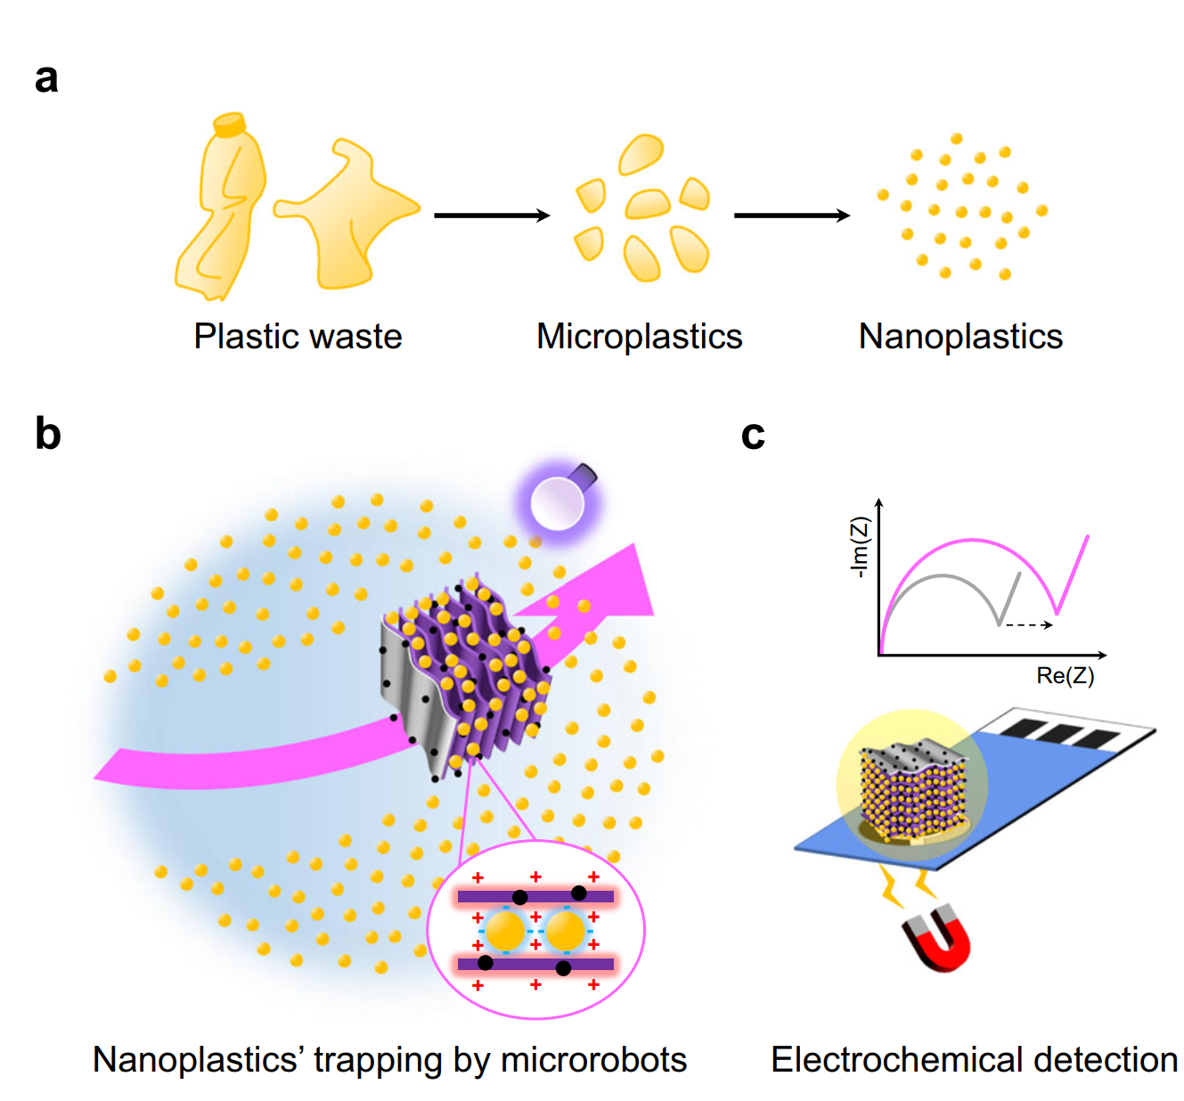
Nanorobots: Biomedicine &

Slide 7
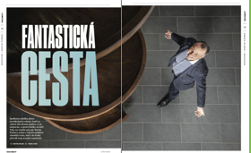
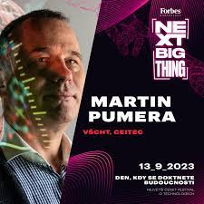
What starts here changes the World
18 Group members – Alumni - are now Professors and Group Leaders (Germany, Spain, Italy, China, Cambridge)
15 Marie Curie Fellowships to the group
61 postdocs
32 students
Total 27M EURO in Career
Total Competitive Funding 12 916 000 EURO/5y (Brno)
8 M CZK external funding TUO ~32M CZK external funding TUO 2024
Min. Edu. (ERDF) OP JAK: 5M EUR (20M)
:2 M EUR
Nat. Ctr. Competence 1.2M (12M E)
It's not about money. It's about the people you have, how you're led, and how much you get it.

