Slide 1
Research Group: Applied Electronics and Electric Drives
Leader: Petr Palacky, Ph.D. Professor, Head of Department
Academic staff members: Martin Kuchar, Ph.D., Dagmar Juchelkova, Ph.D., Vaclav Sladecek, Ph.D., Martin Sobek, Ph.D., Libor Stepanec, Ph.D.
Ph.D. students: Vojtech Sotola, David Bielesz, Richard Blaho, Stepan Kirschner, Marek Kubatko, Robert Kucera, Jan Milata, Kamal Hamani, Huu Chau Minh Nguyen, Dávid Krivánek
Main R&D areas:
Development and implementation of new control methods of electric drives
Modernization of electronic equipments in the area of industrial electronics
Modernization and optimization of electric drives
https://www.fei.vsb.cz/cs/o-fakulte/organizacni-struktura/odborne-skupiny-fakulty/?id=8

Slide 2
Research Group: Applied Electronics and Electric Drives
Sensorless AC Drives
- Methods based on electrical machine mathematical model
State space observers - Luenberger observer, Gopinath observer, Sliding mode observer, Kalman observer etc. Model Reference Adaptive System - Rotor Flux MRAS, Current Based MRAS, Back Electromotive Force MRAS, X-MRAS, Q-MRAS etc.
- Methods without knowledge of electrical machine mathematical model
Artificial intelligence based estimators, soft-computing approaches
Application of soft computing methods and artificial intelligence in electric drives
Artificial neural networks, genetic algorithms, particle swarm optimization, cuckoo search algorithm etc.
Sensor Fault Tolerant Control of AC Drives
Speed sensor failure, stator current sensors failure, DC-link voltage sensor failure
Identification and adaptation of electric machine or observer parameters
Predictive maintenance of induction motors
HW and SW development for microcomputer control systems using DSC, MCU
Design and optimization of electric drives for industry

Slide 3
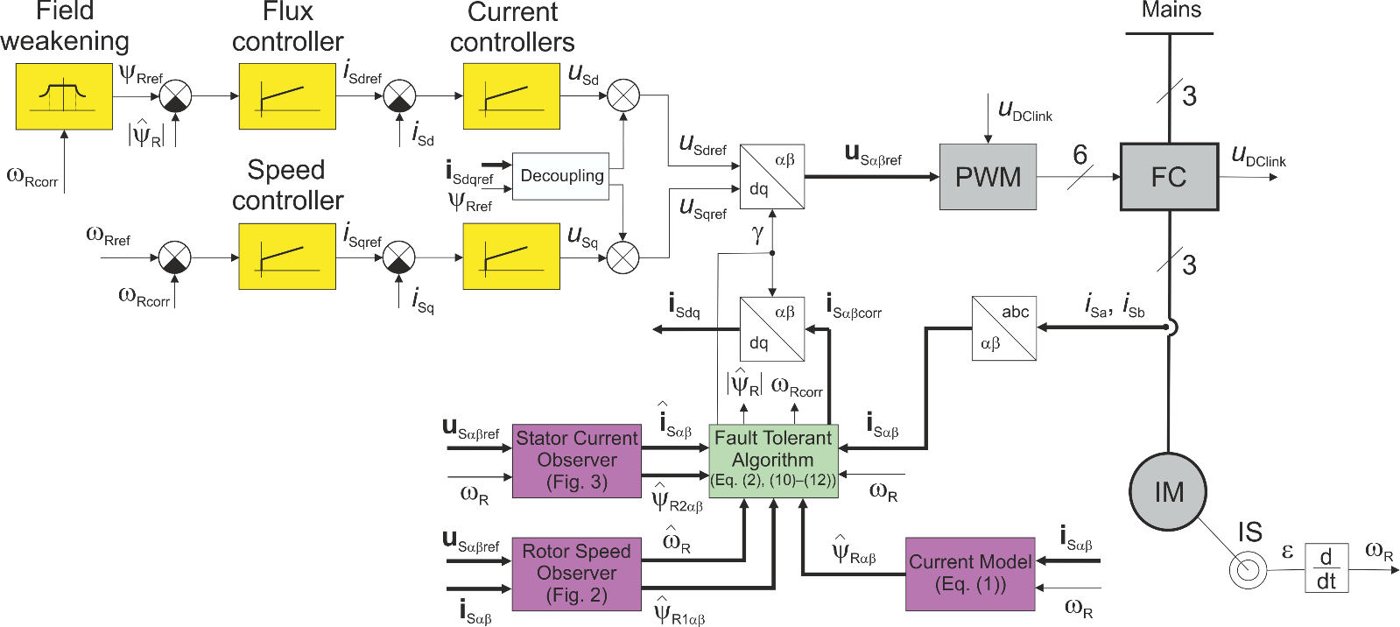
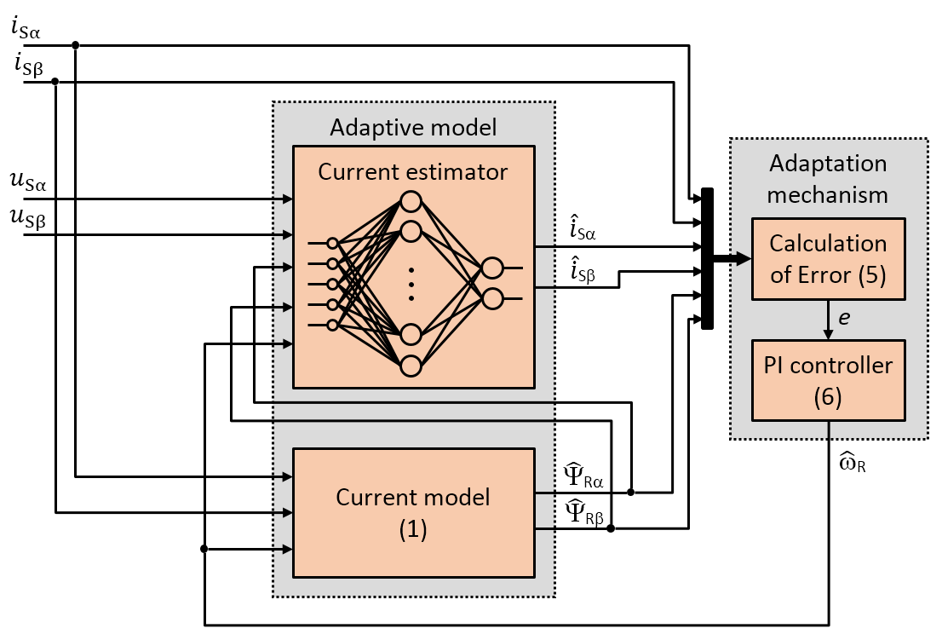
Research Group: Applied Electronics and Electric Drives
Most Important Projects:
Center for Advanced Machines and Manufacturing Technology (CAMAT), TAČR NCK2, TN02000028, 2023-2028.
Research Excellence For REgion Sustainability and Hihg-tech Industries (REFRESH), CZ.10.03.01/00/22_003/0000048, 2023-2027.

Slide 4
Research Group: Applied Electronics and Electric Drives
Main R&D areas:
Development and implementation of new control methods of electric drives
Modernization of electronic equipments in the area of industrial electronics
Modernization and optimization of electric drives
Application of soft computing methods and artificial intelligence
Predictive maintenance of AC motors
HW and SW development for microcomputer control systems using DSC, MCU
Thank you for your attention
prof. Ing. Petr Palacký, Ph.D.
petr.palacky@vsb.cz

