Slide 1
Research Group: Automotive Electronic Systems and Power Electronics
Leader: Petr Simonik, Ph.D., Assoc. Prof. Associate Professor, Vice Dean (FEECS VSB-TUO), Academic Staff Member (430)
Academic staff members: Tomas Mrovec, Ph.D., Tomas Harach, Ph.D., Tomas Klein, Ph.D. Jan Strossa, Ph.D., Ales Havel, Ph.D., Vladislav Damec, Ph.D., Tomas Pavelek, Ph.D.
Ph.D. students: Joy Jason Ligori, Petr Krupa, Miroslav Wondra, Jan Hradilek, Petr Cyprich, Pavel Cyprich
Main R&D areas:
research and development of electronics automotive systems, especially for autonomous, cooperative and connected mobility,
behavioral and operational analyses in frame of automated driving (Level 3, Level 4),
development and implementation of modern power semiconductor converters applying a new switching principles and optimizing the control algorithms,
optimization and electric energy quality factors improving by applying power semiconductors converters,
development of power semiconductors systems intended for electric energy accumulating systems.
https://www.fei.vsb.cz/cs/o-fakulte/organizacni-struktura/odborne-skupiny-fakulty/?id=7

Slide 2
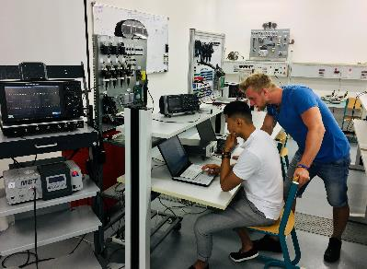
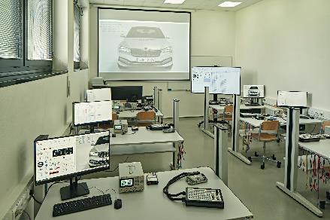
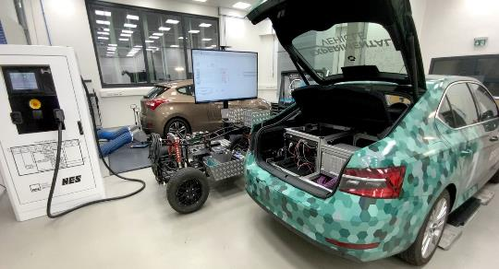
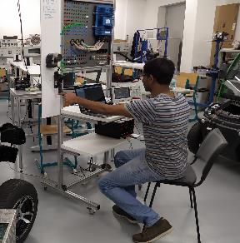
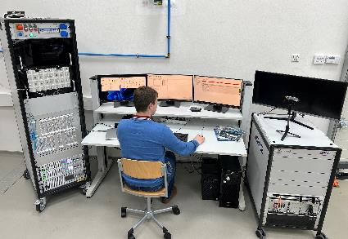
Research Group: Automotive Electronic Systems and Power Electronics
Automated driving, behavioral and operational analyses
Programmable embeded systems, control units and their control algorithms for autonomous, cooperative and connected mobility (using for example NXP, MRS Electronics, AWS platforms), incl. environmental and percepion data analyses and behavioral anlyses.
Modeling, simulation and HiL testing of control systems, sensors and actuators
Modeling and simulation of systems for autonomous, cooperative and connected mobility using Mathworks, Vector Informatik, dSpace, Xylon platforms.
Advanced HiL verification and validation testing alghoritms on Vector Informatik and dSpace platforms.
DC – DC systems - power converters
Systems for coupling a different sets of battery packs containers focused on energy storages cooperating with renewable energy sources.
AC – DC systems - power converters
Systems for coupling DC systems with AC grids focused on the power power factor correction on AC side.
Power Semiconductors switching control techniques.

Slide 3
Projects and cooperation
Screening
Results Processing
Applications
Analyse
R&D
Industrial testbed with 5G NSA
Some of actual projects
HORIZON-Chips-JU (Former KDT-JU-2023-2-RIA, Focus-Topic-2), HAL4SDV, Hardware Abstraction Layer for a European Software Defined Vehicle approach, Czech node coordinator, 2024-2027.
TM04000040: SECURE-RIDE, TAČR DELTA II, CyberSECURity for coopERatIve connecteD automatEd mobility using V2X, AUTOCRYPT Co., Ltd., Korea Automotive Technology Institute, Myongji University Industry and Academia Cooperation Foundation, CEDA MAPS a.s., INTENS Corporation s.r.o., CTU Prague and VSB-TUO, 2023-2025.
101100707: TEF, Digital Europe Programme (EC), AI-MATTERS (AI MAnufacturing Testing and experimenTation network For EuRopean industrieS), the creation of an effective European reference test and experimental facility dedicated to the implementation of artificial intelligence in the European manufacturing sector, 2023-2027.
101083551: EDIH Ostrava, Digital Europe Programme (DIGITAL), Test before Invest services & trainings of SW development tools, ALM/PLM SW, modeling and simulation tools, 2023-2025.
Center for Advanced Machines and Manufacturing Technology (CAMAT), TAČR NCK2, TN02000028, 2023-2028.
Research Excellence For REgion Sustainability and Hihg-tech Industries (REFRESH), CZ.10.03.01/00/22_003/0000048, 2023-2027.

Slide 4
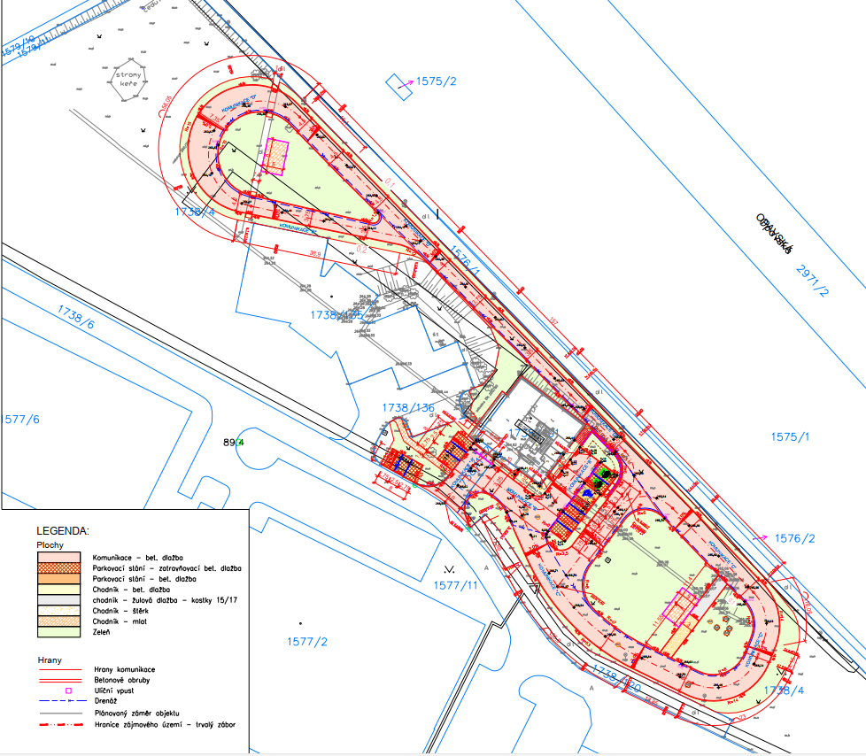
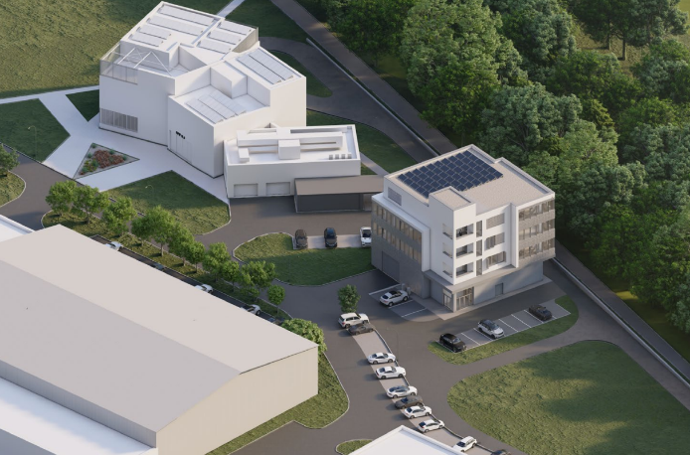
We are constantly working on our infrastructural readiness!
New experimental labs and testing polygon.
In 2024, the construction of new special laboratories and its own closed driving polygon for modeling, simulation and experimental testing of ADAS and automated vehicles will begin.
Possible way to joint experimental testing.
CONTACT – Petr Simonik / +420 604 478 962 / petr.simonik@vsb.cz
Testbed A CPIT TL3
In operation from 2021
Testbed B CPIT TL4 & polygon
Start of construction in 2024

Slide 5
Scientific articles currently being prepared
1. Novel Metod of Predictive Diagnostics for Vehicle Control Systems (Q1)
2. Behavioral Analyses of Drivers in Cars with Level 3+ Automated Driving: A Detailed Analysis (with Newcastle University, prof. Suganthan, R&D Valeo), (Q1)
3. Steering Angle Estimation for Automated Driving as Analytical Redundancy for Fail Safe Fail Operational Mode (with R&D Valeo), (Q1)
4. Novel Method for Redundant Lateral Steering System - New Concept Study (Q2)
5. New Roof Top Reference System for Perception Data Colletion (with Newcastle University, R&D Valeo) (Q2)
6. New Adaptive Method on Target Distance for Cooperative Adaptive Cruise Control (data collection with Skoda Auto and VW), (Q2)
7. In-Vehicle Icy Road Detection and Sharing over C-ITS Infrastructure (Q2)
8. Intelligent Detection of Icy Roads in the C-ITS Platform (Q1)
CONTACT – Petr Simonik / +420 604 478 962 / petr.simonik@vsb.cz

