Slide 1
Network Technologies and Applications
Team
Miroslav Vozňák (head of RG)
Academic and Research staff (14)
PhD. Students (8)
Received Funding from
Competencies
Network protocols and technologies
Network security
IoT, Sensor networks
Knowledge retrieval from networks
Speech processing, Speech codecs and IP telephony
Quality of Service and Quality of User Experience in Networks

Slide 3
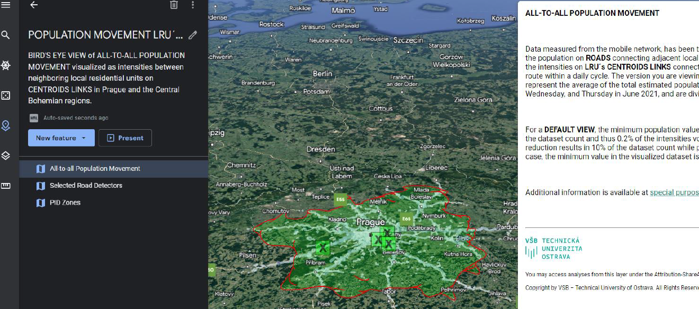
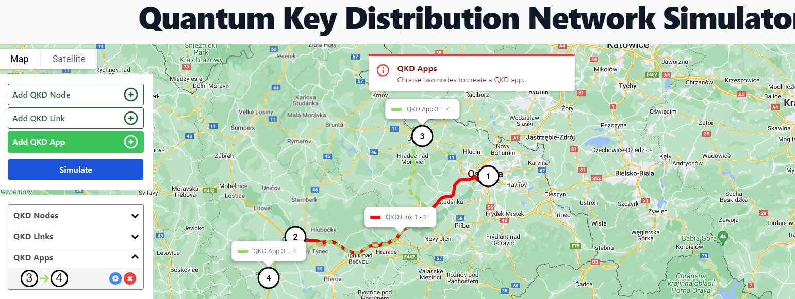
Selected Projects
OpenQKD (2019-2023), H2020
Quantum5 (2021-2024), NATO
Network Cybersecurity in Post-Quantum Era (2021-2025), MVCR
GNSS signal interference detector for integrated safety means in road transport, (2021-2024), TACR
Support system for evaluation of perioperative radiographs of resected breast tissue (2024-2026), TACR

Slide 4
Network Technologies and Applications
We are looking for talented FPGA developers to cooperate with us
mailto: miroslav.voznak@vsb.cz

