Slide 1



From Passion to Promotion: Harnessing the Power of Your Research for Maximum Impact
Seyedali Mirjalili
Professor, Director
Centre for Artificial Intelligence Research and Optimisation, Torrens University Australia
An AI generated image

Slide 2
DISCLAIMERS
Contribution is everything. This seminar is not about contribution but rather how to look at research through the lens of promotion and visibility.
“Publish or Perish” does not mean sacrificing quality over quantity.
No silver bullet, but I am sharing what worked for me.
I have done most of these unintentionally simply because I was so passionate about research.

Slide 3

FACT
An AI generated image
Non-citation rates vary enormously by field (Williams, 2019)
  “Only” 12% of medicine articles are not cited, compared to about 82% for the humanities.
  It’s 27% for natural sciences and 32% for social sciences
3
https://blogs.lse.ac.uk/impactofsocialsciences/2014/04/23/academic-papers-citation-rates-remler/#:~:text=%E2%80%9C90%25%20of%20papers%20published%20in,were%20said%20to%20be%20uncited.

Slide 4

WHY?
What are the reasons for this?
What do you think?
4
An AI generated image

Slide 5
WHAT DOES CHATGPT THINK?
Poor quality: The publication may be of poor quality, with weak methodology, flawed data analysis, or inadequate presentation of findings, which can make it less likely to be cited by others.
Lack of relevance: The publication may not be relevant to the research interests of other scholars or practitioners in the field, and thus may not attract any attention or citations.
Limited audience: The publication may be aimed at a narrow or specialized audience, which may limit its visibility and appeal to a broader readership.
Timing: The publication may have been published at a time when the research area was not yet established, or when there was little interest in the topic, which can limit its visibility and impact.
Language barriers: The publication may be written in a language that is not widely spoken or understood, which can limit its accessibility to researchers and practitioners in other countries or regions.
Competition: The publication may face stiff competition from other publications that cover similar topics or have more established reputations, making it less likely to be cited.
Citation practices: The publication may not be cited due to factors outside the control of the author, such as changes in citation practices or standards in the field, or due to factors related to the indexing or search algorithms of databases or search engines.
Limited dissemination: The publication may not have been widely disseminated, such as being published in a low-profile journal or not being promoted effectively by the author.
5
An AI generated list

Slide 6


PROMOTING RESEARCH OUTPUTS
Papers “visible” in publishers
Less than 20%
If you leave it to the publisher, you are very likely to end up in the 80% group
So how do we increase the visibility of our papers and research?
Papers “invisible” in publishers
Over 80%
6

Slide 7
THE WHO & THE WHAT?
  Institution: Play a crucial role in supporting and promoting the research.
    Providing resources such as funding, research support staff, and library services.
    Institutions can also establish policies and programs to encourage open access publishing and data sharing.
    Initiatives to hold research events, hiring high-profile academic, improving research culture, etc.
    …
  Faculties: Faculties can encourage their members to engage in best practices for disseminating research outputs
    Creative list of preferred (Q1/Q2) journals
    Incentivize high quality publications
    Professional dev plan for staff
    Mentorship and support for early-career researchers
    Defining projects on hot, trending areas with potentially high citations (e.g. COVID, ChatGPT, etc.)
    …
  Researchers:
    Engaging in media
    Networking and collaboration
    Using social media
    Outreach activities
    …
7

Slide 8


BUSINESS VS. ACADEMIA
Business
Choose an market
Market/product analysis
Manufacture or source product
Tailor the product
Quality control
Packaging
Shipment
Marketing
Academia
Choose an area
Literature review to find gaps
Hypotheses
Experiment/data collection
Analysis
Writing
Publish
???

Slide 9

WE CAN LEARN FROM BUSSINESS LEADERS
An AI generated image

Slide 10











{….}
Product:
Objective: Maximize profit/customer satisfaction
Product:
Objective: Maximize research impact
Step 1: product and market research
Step 2: manufacture or source product
Step 3: marketing and branding
Step 1: finding gaps and __________
Step 2: preparing and publishing outputs, ________
Step 3: _____________

Slide 11

AN INTERESTING STRATEGY
{….}
Product:
Before writing a paper
Step 1: finding gaps and audience research
Step 2: preparing and publishing paper, code, data, visualization, etc.
Step 3: marketing and branding
During writing a paper
After publishing a paper

Slide 12

STEP 1: BEFORE WRITING A PAPER
Gaps (which gap has a broader audience): give priority to the gaps
Audience research: who are your writing for
Targeting different audiences: diversity is the key
Targeting different journals/publishers to cater different demographic: Elsevier, Springer, IEEE, …
Research the current highly-cited papers in your area and inspire

Slide 13
STEP 1: BEFORE WRITING A PAPER
Gaps (which gap has a broader audience): give priority to the gaps
Audience research: who are your writing for
Targeting different audiences: diversity is the key
Targeting different journals/publishers to cater different demographic: Elsevier, Springer, IEEE, …
Research the current highly-cited papers in your area and inspire
Writing style and story telling
EXAMPLES:
Two papers for a small audience group (niche product):
Two paper for a big audience group (general product):

Slide 14
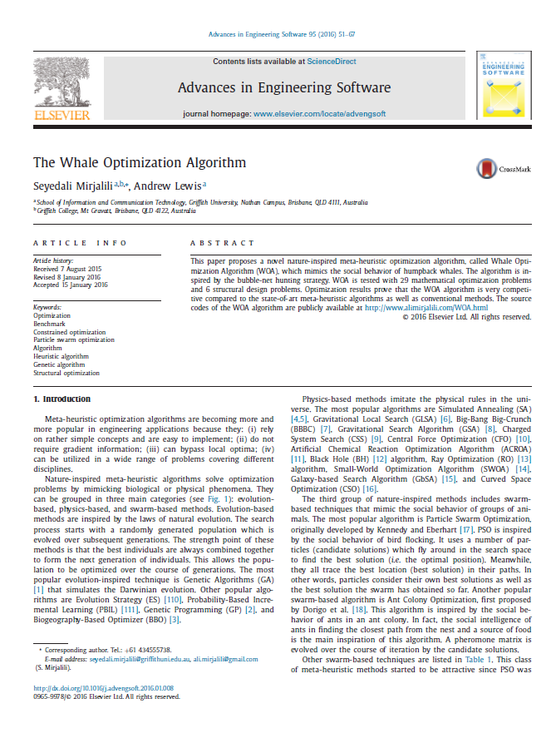

STEP 2: DURING WRITING A PAPER
Title research: as unique as possible and eye catching
Keyword research: as popular as possible
Abstract: full of popular keywords
Branding: include website, email, same name, never use abbreviation, etc
Mini survey: makes a bigger audience demographic
Content quality quality matters, lots of visualization, …

Slide 15
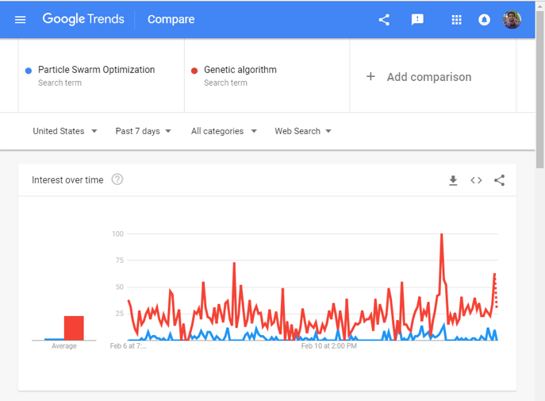
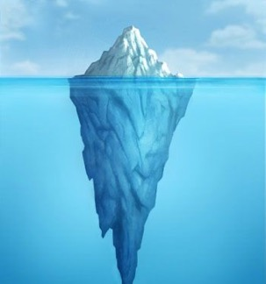
STEP 2: DURING WRITING A PAPER
Where to find keywords?
Google AdWords
Google Trend
…
Popular keywords

Slide 16
STEP 3: AFTER PUBLISHING A PAPER
Basically, you have to drive traffic to your research outputs to increase “conversion rate”.
Uploading the final accepted version in as many websites if you are allowed: Academia, ResearchGate, etc.
  Free marketing
  Personal branding
Personal website (very important): http://www.seyedalimirjalili.com
  Content marketing
  Personal branding
  “Upsell” and “Cross-sell”
Sharing code and data in as many websites as possible: Make them as easy as possible to use and understand https://au.mathworks.com/matlabcentral/profile/authors/2943818-seyedali-mirjalili

Slide 17
EFFECTIVE STRATEGIES FOR INCREASING CITATION FREQUENCY
Use A Unique Name Consistently Throughout Academic Careers
Use a standardized institutional affiliation and address, using no abbreviations
Repeat key phrases in the abstract while writing naturally
Assign keyword terms to the manuscript
Make a unique phrase that reflects author's research interest and use it throughout academic life
Avoid boring titles and use eye-catching (“sexy”) titles
Publish in journal with high impact factor
Self-archive articles (when allowed of course)
Keep your professional web pages and published lists up to date
Make your research easy to find online
Open Access increases citation rate
Deposit paper in Open Access repository (when allowed of course)
Publish with international authors
Team-authored articles get cited more
Use more references
Publish a longer paper
Contribute to Wikipedia
Start blogging

Slide 18
EFFECTIVE STRATEGIES FOR INCREASING CITATION FREQUENCY
Join academic social networking sites
Write a review paper
Share your research data (when allowed of course)
Publish across disciplines
Present and participate in conferences
Publicize yourself
Create videos and podcasts in your area
Create an online CV and a personal website
Publish tutorial papers or make your papers educational too
Write books as thousands of third-party seller will promote your brand
For more information, please refer to: Ale Ebrahim, Nader, et al. "Effective strategies for increasing citation frequency." International Education Studies 6.11 (2013): 93-99.

Slide 19
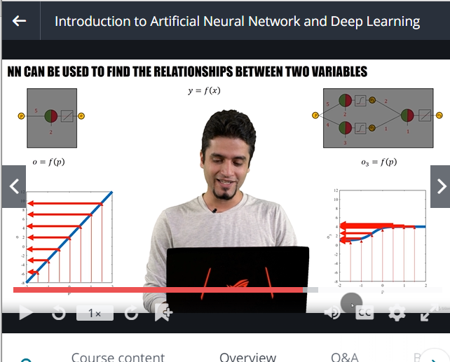

BEFORE YOU ASK
My recent initiatives:
Writing books
Online videos and courses
Media interviews
19

Slide 20
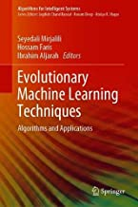





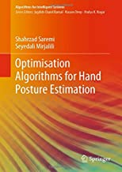

1. WRITING BOOKS
Rational:
Enjoy the new experience
Passion of wiring about nature-inspired algorithms
Book publishers will promote my research and my brand
Target a wider range of audience

Slide 21















BOOK PUBLISHERS
And thousands more publishers are promoting my brand.

Slide 22




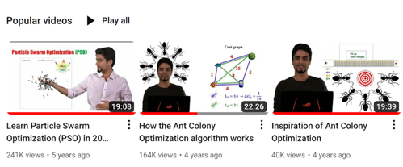




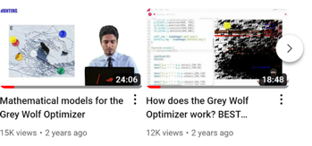
2. ONLINE COURSES
Rational:
Passion for teaching
Teach my content and make it easy to comprehend and use
Engaging audience with my personality and teaching style
Build trust

Slide 23










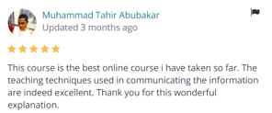
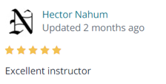
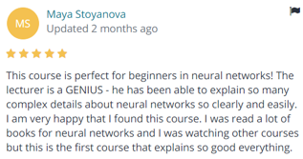
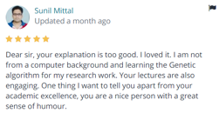

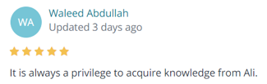
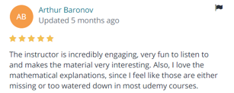



IMPACT OF ONLIE COURSES

Slide 24
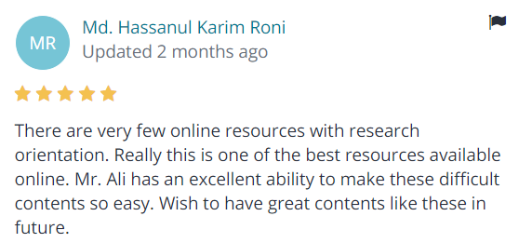
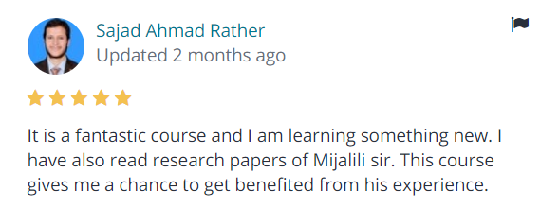
I wanted to make my research easy to learn and use, and it seems to be working

Slide 25
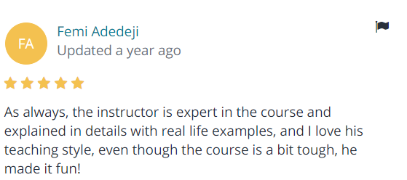
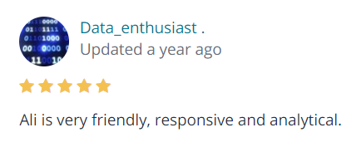
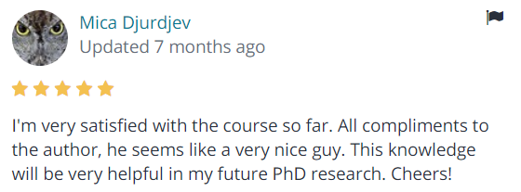
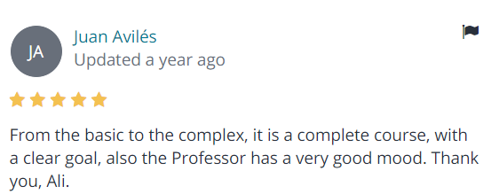
BUILDING TRUST

Slide 26
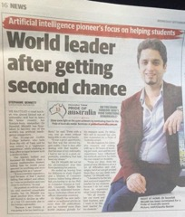

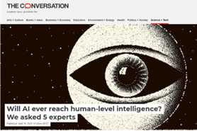
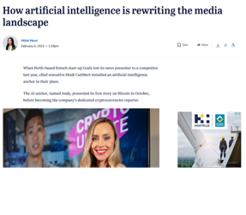





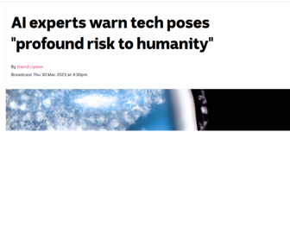

MEDIA

Slide 27
LET’S SEE HOW THESE ALL CAN MAKE A DIFFERENCE
IN TERMS OF CITATIONS

Slide 28
























EVERY MONTH
www.seyedalimirjalili.com
10,000 visits
5,000 subscribers
8,000 views
5,000 students
15,000 visitors
void main()
{
cout>> “Hi”;
}
2,000 page views
1,000 downloads

Slide 29









IT IS SIMPLE
My traffic
Publishers’ and indexing companies’ traffic
A lot more, but let’s say a minimum of
void main()
{
cout>> “Hi”;
}
~30,000
~30,000
60,000 views per month * 1% of them cite = 600 citations per month

Slide 30
FINAL THOUGHTS
Any of these techniques can increase the visibility of your research
Never be afraid of experimenting in this space. Try different ways to promote your work and see which one works well in your area.
Spend time to make your research more visible; it is significantly easier than doing the research itself
Keep the audience in mind
Impress the audience with your content
and rest assure that you will be rewarded!

Slide 31
REMEMBER, SINCE NOT MANY ACADEMICS ARE AWARE OF THESE, IT CAN MAKE A BIG DIFFERENCE FOR YOU

Slide 32

THANK YOU
Q&A
An AI generated image

