Slide 1
Quantum Computing: A Gentle Introduction
Dr. Siddhartha Bhattacharyya
Senior Researcher
VSB Technical University of Ostrava, Ostrava, Czech Republic
dr.siddhartha.bhattacharyya@gmail.com
‪Siddhartha Bhattacharyya‬ - ‪Google Scholar‬

Slide 2
What is the Value of 2+2?
In a Classical Computer, adding two bits, we only get:
𝑏₁𝑏₂+𝑏₃𝑏₄=𝑏_{𝑐}𝑏₄𝑏₅; 10+10=100
In a Quantum Computer, adding two Qbits, we get:
𝑞₁𝑞₂+𝑞₃𝑞₄=𝑞_{𝑐}𝑞₄𝑞₅⇒ 000, 001, 010, 011, 100, 101, 110, 111
SUPERPOSED ⇒ α|000>+β|001>+γ|010>+δ|011>+ε|100>+κ|101>+λ|110>+μ|111>
with α² + β² + γ² + δ² + ε² + κ² + λ² + μ² = 1

Slide 3
Layout
A real IBMQ machine
Why do we need a Quantum Computer?
A Brief Introduction
Classical Bits vs. Qubits
Quantum Superposition
Quantum Entanglement
Quantum Gates
Quantum Computer Architectures
4/21/2025
3

Slide 4
How does a Quantum Computer look like?
radio-frequency control and readout lines
4 K
800 mK
100 mK
14 mK
superconducting
qubits
coupling between qubits via resonators
cryostat temperature
0.014 K
“Demonstration of a quantum error detection code using a square lattice of four superconducting qubits”, A.D. Córcoles et al., Nat. Comm., 6:6979 (2015)
An Image from IBM Q
4/21/2025
4

Slide 5
How to Use a Quantum Computer
5

Slide 6
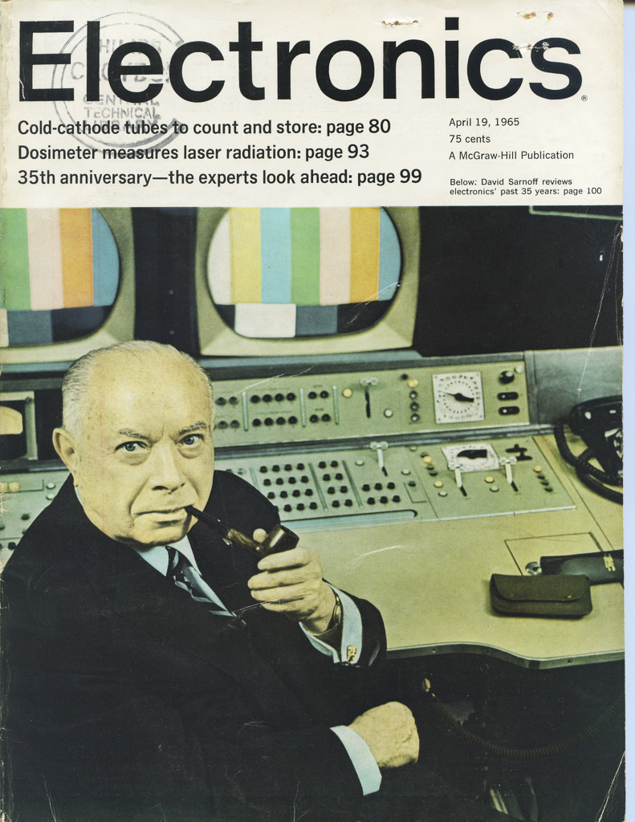
Why do we need a Quantum Computer?
Electronics April 19, 1965
Seminal paper (1965) by Gordon Moore
Moore's Law states that the number of transistors in a dense integrated circuit doubles about every two years.
In 1975, it reached an astonishing number of 65,000.
Revised Moore’s Law
“The number of transistors on a microchip doubles about every two years, though the cost of computers is halved”.
Experts agree that computers should reach the physical limit of Moore’s Law sometime in 2020s.
High temperatures of transistors will make it difficult to create smaller circuits.
4/21/2025
6

Slide 7
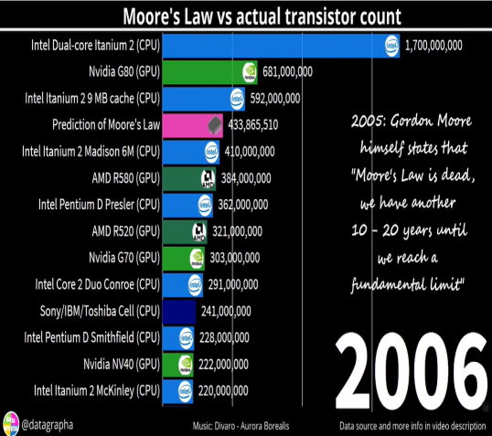
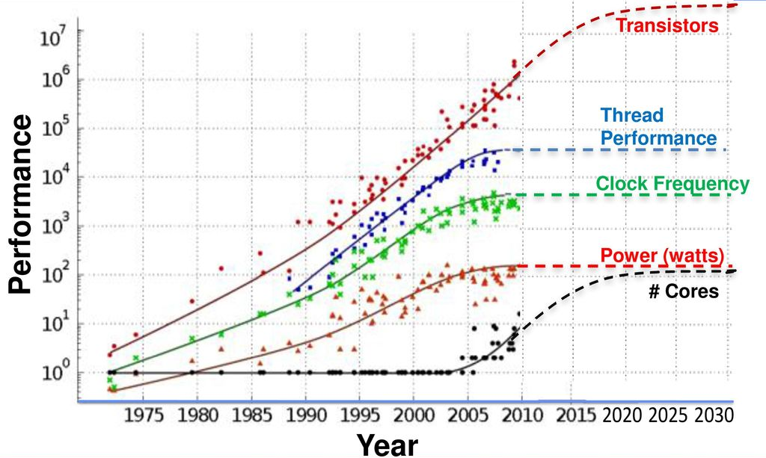
Moore’s Law
Moore’s Law
Moore’s Law Seems to be Slowing Down
Quantum computers may be the answer when Moore’s Law fails.
4/21/2025
7

Slide 8
A Brief History - Milestones
1981
Proposed by Nobel laureate Richard Feynman.
Classical computers cannot simulate the evolution of quantum systems in an efficient way.
Predicted that a quantum computer can exponentially outpace classical computers.
1994
Peter Shor developed Shor’s algorithm
Efficiently factorizes large integers exponentially and more quickly than the best classical algorithms on traditional machines.
Theoretically, Shor’s Algorithm is capable of breaking many of the cryptosystems used today.
1996
Lov Grover invented a quantum database search algorithm
Quadratic speedup for a variety of problems. Any problem that had to be solved by random or brute-force search could now be done 4 times faster.
4/21/2025
8

Slide 9
A Brief History - Milestones
1998
A working 2-qubit quantum computer was built to solve the first quantum algorithm, such as Grover’s algorithm.
2017
IBM presented the first commercially usable quantum computer, raising the race to another level.
29th September 2020
D-Wave announced a commercial 5000+ qubit machine.
4/21/2025
9

Slide 10
Classical Bit
If we take 1 bit, we can represent two numbers, i.e., 0 and 1.
Simultaneously if we take 2 bits, we can represent 4 numbers:
0 | 0 | 00
0 | 1 | 01
1 | 0 | 10
1 | 1 | 11
But any time no matter how many bits we use we can only store 1 value.
For example, if we take 2 bits we can represent either 00 or 01 or 10 or 11 at a time. We cannot use the same bits to simultaneously represent more numbers.
To represent 4 numbers, we need 8 bits.
0
1
Representation of a classical bit
4/21/2025
10

Slide 11
Qubit or Quantum Bit
|0⟩
The basic entity of quantum information is a qubit (pronounced “cue-bit”), or a quantum bit (or qbit).
The term was coined by Benjamin Schumacher in 1995.
A qubit unless measured, can exist in both the states |0⟩ and |1⟩.
Also known as computational basis states.
So if we take 2 qubits it can be in 4 states simultaneously.
An n qubit system can exist in all 2^{n} superposition states simultaneously compared to classical computers which can represent any one of the 2^{n} states.
|1⟩
A Qubit
4 qubit system with 16 states represented simultaneously in IBM Q
4/21/2025
11

Slide 12
Qubit Representation
Qubit is represented using a column vector notation-‘| ⟩’- called ‘ket’ in Dirac’s notation, in Hilbert space.
A Hilbert space is equipped with an inner product, which is an operation that can be performed between two vectors, returning a scalar. This is the main difference between a Hilbert space and any random vector space.
Qubits can also be represented as orthogonal vectors as follows: |0⟩ =$\left[\begin{matrix}1 \\ 0\end{matrix}\right] and$|1⟩ = $\left[\begin{matrix}0 \\ 1\end{matrix}\right]$.
The state |0⟩ is called the ground state and |1⟩ is called the excited state.
4/21/2025
12

Slide 13
Quantum Computing Fundamentals
Superposition is the property of the dynamical equations of quantum mechanics. Due to the linear dynamics, the linear combination of each possible solution in a quantum mechanical system is also a solution.
A qubit can also exist in a linear combination of states, called superposition.
A superposition state can be written as |Ψ⟩ = α|0⟩ + β|1⟩, where α and β are complex numbers of the form z= x + iy where, i=$\sqrt{−1}$
|α|²: probability of finding |Ψ⟩ in state |0⟩
|β|²: probability of finding |Ψ⟩ in state |1⟩
Computational Basis States of a Qubit
from IBM Q
Bloch Sphere representation from Qiskit
4/21/2025
13

Slide 14
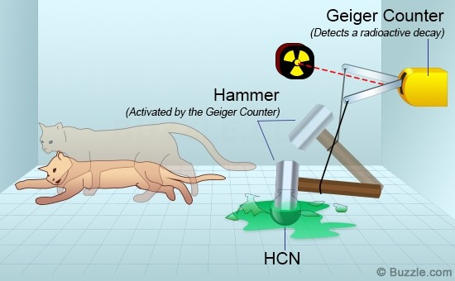
Schrodinger’s Cat: A thought experiment
Erwin Schrodinger was among the pioneers of quantum mechanics. He designed this strange thought experiment to explain the quantum superposition principle.
Imagine a cat placed in a box with a radioactive source, a flask of poison, and a Geiger counter.
If the radioactive source decays
the mechanical system associated with it operates and breaks the flask. As a result, the cat dies.
If the source does not emit radiation, the cat stays alive.
Schrodinger’s Cat : A thought experiment
4/21/2025
14

Slide 15
Schrodinger’s Cat: A thought experiment
Radioactivity is a probabilistic quantum phenomenon.
The source may or may not decay and give off radiations.
Before the box is opened and its contents are revealed, just as the radioactive source has equal chances of being decayed or not
the cat would have equal chances of being poisoned or spared.
The real question is whether the cat is dead or alive.
Quantum mechanics suggests that the cat is neither dead nor alive but in the superposition of both states.
Once someone opens the box
the combined states collapse into one of the two possibilities.
4/21/2025
15

Slide 16
Bloch Sphere Representation of a Qubit
Qubits can be represented geometrically using a Bloch Sphere.
We know that |Ψ⟩ = α|0⟩ + β|1⟩, where α and β are complex numbers.
If we take α and β to be real numbers and add an imaginary term е^{ίФ}
|Ψ⟩ = α|0⟩ + е^{ίФ} β|1⟩.
Since |α⟩²+|β⟩²=1, using trigonometry, then
$\sqrt{\sin^{2}x+\cos^{2}x}$ = 1
With α =$\cos{\frac{θ}{2}}$ and β=$\sin{\frac{θ}{2}}$. Hence,
|Ψ⟩ = $\cos{\frac{θ}{2}}$|0⟩ + $\text{е}\text{ί}\text{Ф}sin{\frac{θ}{2}}$|1⟩
If we interpret θ and ϕ as spherical coordinates (r =1, since the magnitude of the qubit state is 1), we can plot any qubit state on the surface of a sphere, known as the Bloch sphere.
Fig 10. Bloch Sphere Representation
4/21/2025
16

Slide 17
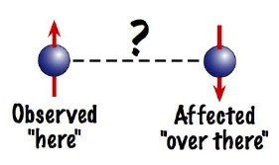
Example of Entanglement
4/21/2025
17

Slide 18
Entanglement is the property that generally gives rise to non-local interaction among bipartite correlated states.
To Understand Entanglement, let me present a short story of Alice and Bob.
Event 01:
Once upon a time, Alice and Bob lived in Australia.
They grew up in their respective hometowns.
Event 02:
Suddenly, Bob met Alice.
They fell in love with each other.
Event 03:
Subsequently, they got married to each other.
Event 04:
They were living happily when Alice got pregnant.
Event 05:
Unfortunately, after a few months, Bob had to shift to the States for his job, leaving Alice behind.
Event 06:
Days passed by. After a gap of several months, Alice gave birth to a child.
Event 07:
Notably enough, the moment Alice gave birth to the child, Bob became a father without even knowing that Alice had delivered.
Bob’s state thus changes to that of a father.
4/21/2025
18

Slide 19
Analogy with Quantum Entanglement
Alice and Bob got entangled when they got married.
The property of entanglement states that when the state of one of the entangled states changes, the state of the other state automatically changes.
So, when the state of Alice changes to a mother, the state of Bob automatically changes to that of a father.
4/21/2025
19

Slide 20
Quantum Measurement
If one prepares a quantum system in the laboratory, the position or energy of constituent states is measured.
After measurement, the state of a system is said to “collapse” into an eigenstate of the operator corresponding to the measurement.
If the measurement is repeated without allowing the quantum state to evolve further, it will always lead to the same result.
If, however, the preparation is repeated, subsequent measurements are supposed to give different results.
A probability distribution, or an “average” (or “expectation”) of the measurement operator used on the quantum state of the prepared system, sufficiently describes the predicted values of the measurement.
4/21/2025
20

Slide 21
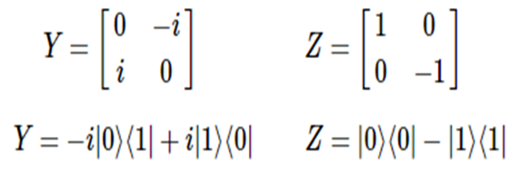
Quantum Gates
Quantum gates are unitary operators.
A unitary operator U is one where the adjoint is equal to the inverse, meaning U† =U⁻¹. The defining relation for a unitary operator is thus,
UU† = U†U = I
Pauli Gates:
The Pauli-X matrix represents the X-gate as:
The X-gate switches the amplitudes of the states |0⟩ and |1⟩ as:
Similar to the X-gate, the Y & Z Pauli matrices also act as the Y & Z-gates in quantum circuits.
The Hadamard gate (H-gate) is a fundamental quantum gate.
It allows us to move away from the poles of the Bloch Sphere and create a superposition of |0⟩ and |1⟩.
The corresponding matrix is as follows:
4/21/2025
21

Slide 22
Quantum Computer Architectures
Quantum annealer (D-Wave)
Specialized: optimization problems → find lowest energy level
Uses tunneling and entanglement
Better than classical? → unknown, maybe significant speedup
Approximate quantum [gate] computer (IBM Q, Regetti, IonQ…)
More general: optimization, quantum chemistry, machine learning
Superposition, entanglement
Better than classical? → likely, sign. speedup for more problems
Fault-tolerant quantum computer (in some years from now)
Deals w/ errors (noise) algorithmically
Most general: crypto, search, and any of the above ones
Need 1000 physical qubits per virtual (“error-free”) qubit
Better than classical? → proved theoretically
4/21/2025
22

Slide 23
Quantum Computer Frameworks
IBM
Architecture - Superconducting
Platform - Qiskit
Google
Architecture - Superconducting
Platform - Cirq
Microsoft
Architecture – Trapped Ion
Platform - Azure Quantum
Amazon
Architecture – Superconducting, Trapped Ion, Photonic
Platform - Braket
Xanadu
Architecture - Photonic
Platform - Pennylane, Strawberry Fields
4/21/2025
23

Slide 24
What is a qubit, physically?
It must be, in some sense, small enough to be quantum mechanical (which is why QC is usually nanoscale)
Some examples:
Photons (N. B. NIST QKD testbed)
Quantum Dots
Single Cooper-Pair Boxes
Josephson-Junction Circuits (N. B. Martinis’s program)
Nuclear spins in liquids
Electron/nuclear spins in solids
Single Isolated Ions (N. B. Wineland’s program)
Single Isolated Atoms
etc.
4/21/2025
24

Slide 25
Photonic Quantum Computer
4/21/2025
25

Slide 26
Optical Quantum Circuit
4/21/2025
26

Slide 27
Optical Quantum Circuit
4/21/2025
27

Slide 28
Photons as Qubits
(a) A qubit — a quantum 'bit' of information — can be encoded using the horizontal (|H〉) and vertical (|V〉) polarization of a single photon. (b) An arbitrary state of a qubit can be represented on the Bloch sphere (known as the Poincaré sphere in optics). Examples of diagonal (D), anti-diagonal (A), right circular (R) and left circular (L) are shown. (c) A half-waveplate (λ/2) can be used to rotate the qubit's polarization. (d) A polarization-encoded qubit can be interconverted to a path-encoded qubit through a polarizing beam splitter (PBS).
Photonic quantum technologies, Nature Photonics, 2009
4/21/2025
28

Slide 29
Super Conducting Quantum Universal Gate Computer
4/21/2025
29

Slide 30
Josephson Tunnel Junction
4/21/2025
30

Slide 31
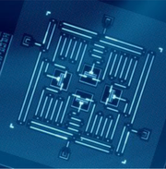
Cooper-pairs
In quantum computing, a charge qubit (also known as Cooper-pair box) is a qubit whose basis states are charge states (i.e. states representing the presence or absence of excess Cooper pairs in the island).
A charge qubit is formed by a tiny superconducting island coupled by a Josephson junction (or, practically, superconducting tunnel junction) to a superconducting reservoir.
The qubit's state is determined by the number of Cooper pairs that have tunneled across the junction.
A transmon [transmission line shunted plasma oscillation qubit] is a type of superconducting charge qubit designed to have reduced sensitivity to charge noise.
a Cooper-pair box "where the two superconductors are also capacitively shunted to decrease the sensitivity to charge noise while maintaining a sufficient anharmonicity for selective qubit control.”
A device consisting of four transmon qubits, four quantum buses, and four readout resonators fabricated by IBM and published in npj Quantum Information in January 2017
4/21/2025
31

Slide 32
Scaling IBM Quantum Technology
4/21/2025
32

Slide 33
Quantum Annealer (D-Wave)
4/21/2025
33

Slide 34
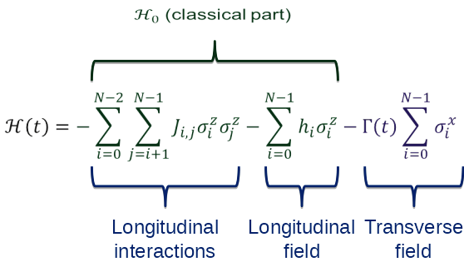
Simulated Annealing
Quantum Mechanics to the Rescue
Classical (and classic) optimization approach
Find the coordinates of the minimum value in an energy landscape
Conceptual approach
Drop a bunch of rubber balls on the landscape, evaluating the function wherever they hit
Hope that one of the balls will bounce and roll downhill to the global minimum
Challenge: Commonly get stuck in a local minimum
Consider adding a time-dependent transverse field to a 2-local using Hamiltonian:
Implication of adiabatic theorem: Let’s gradually decrease the amplitude of the transverse field, Γ(t), from a very large value to 0 → should drive the system into the ground state of H₀
The real benefit: quantum tunneling
4/21/2025
34

Slide 35
Quantum Tunneling
Introduced by the Γ(t) (transverse) term
Enables jumping from one classical state (eigenstate of H₀) to another
Decreases likelihood of getting stuck in a local minimum
Unlike simulated annealing, width of energy barrier is important, but height is not
4/21/2025
35

Slide 36
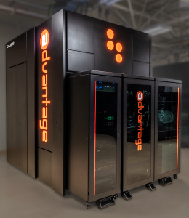
Processing Using D-Wave
A lattice of superconducting loops (qubits)
Chilled near absolute zero to quiet noise
User maps a problem into search for “lowest point in a vast landscape” which corresponds to the best possible outcome
Processor considers all possibilities simultaneously to satisfy the network of relationships with the lowest energy
The final state of the qubits yields the answer
DWAVE 5000 Qubits Machine
4/21/2025
36

Slide 37
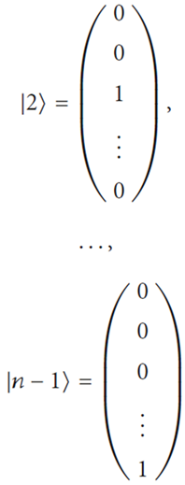
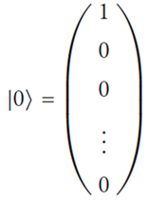
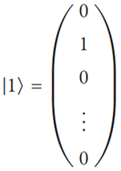
Multilevel Quantum Systems
In general, the number of states of a quantum system is equal to 𝑛, the number of levels in the multilevel quantum system.
In contrast to a qubit, a qudit is a quantum unit of information, which may be in any of 𝑛 basis states |0⟩, |1⟩, |2⟩,... |𝑛 − 1⟩ or in any superposition of those.
|𝑞⟩ = 𝛼₁|0⟩ + 𝛼₂|1⟩ + 𝛼₃|2⟩ + . . . + 𝛼_{𝑛}|𝑛 − 1⟩
with a normalization constraint:
𝛼₁² + 𝛼₂² + 𝛼₃² + . .. + 𝛼_{𝑛}² = 1
4/21/2025
37

Slide 38
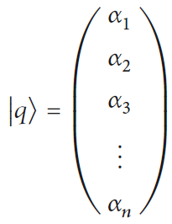
State of a Qudit
The state of the i^{th} qudit is determined by the amplitudes of probabilities {𝛼₁, 𝛼₂^{𝑖}, 𝛼₃^{𝑖}, . . . , 𝛼_{𝑛}^{𝑖}} as:
|n − 1⟩ — 𝛼_{𝑛}^{𝑖}
|n − 2⟩ — 𝛼_{𝑛-1}^{𝑖}
... ... ...
|1⟩ — 𝛼₂^{𝑖}
|0⟩ — 𝛼₁^{𝑖}
4/21/2025
38

Slide 39
Some Application Areas
Artificial intelligence
Better batteries
Cleaner fertilization
Cybersecurity
Drug development
Electronic materials discovery
Financial modeling
Solar capture
Traffic optimization
Weather forecasting and climate change
Sensors
4/21/2025
39

Slide 40
References
www.visualcapitalist.com/visualizing-moores-law-in-action-1971-2019/
D. Mcmohan, ``Quantum computing explained’’, in John Wiley & Sons Inc., Hoboken, New Jersey, 2008.
R. P. Feynman, ``Simulating physics with computers’’, International Journal of Theoritical Physics, vol. 21, pp. 467–488, 1982.
D. Deutsch, R. Jozsa, `` Rapid solution of problems by quantum computation’’, in Proceedings of the Royal Society of London. Series A: Mathematical and Physical Sciences, vol. 439 (1907), pp. 553–558, 1992.
C. Fisher, (2020, October 11), IBM | Quantum Computing, Retrieved from https://www.ibm.com/quantum-computing
4/21/2025
40

Slide 41
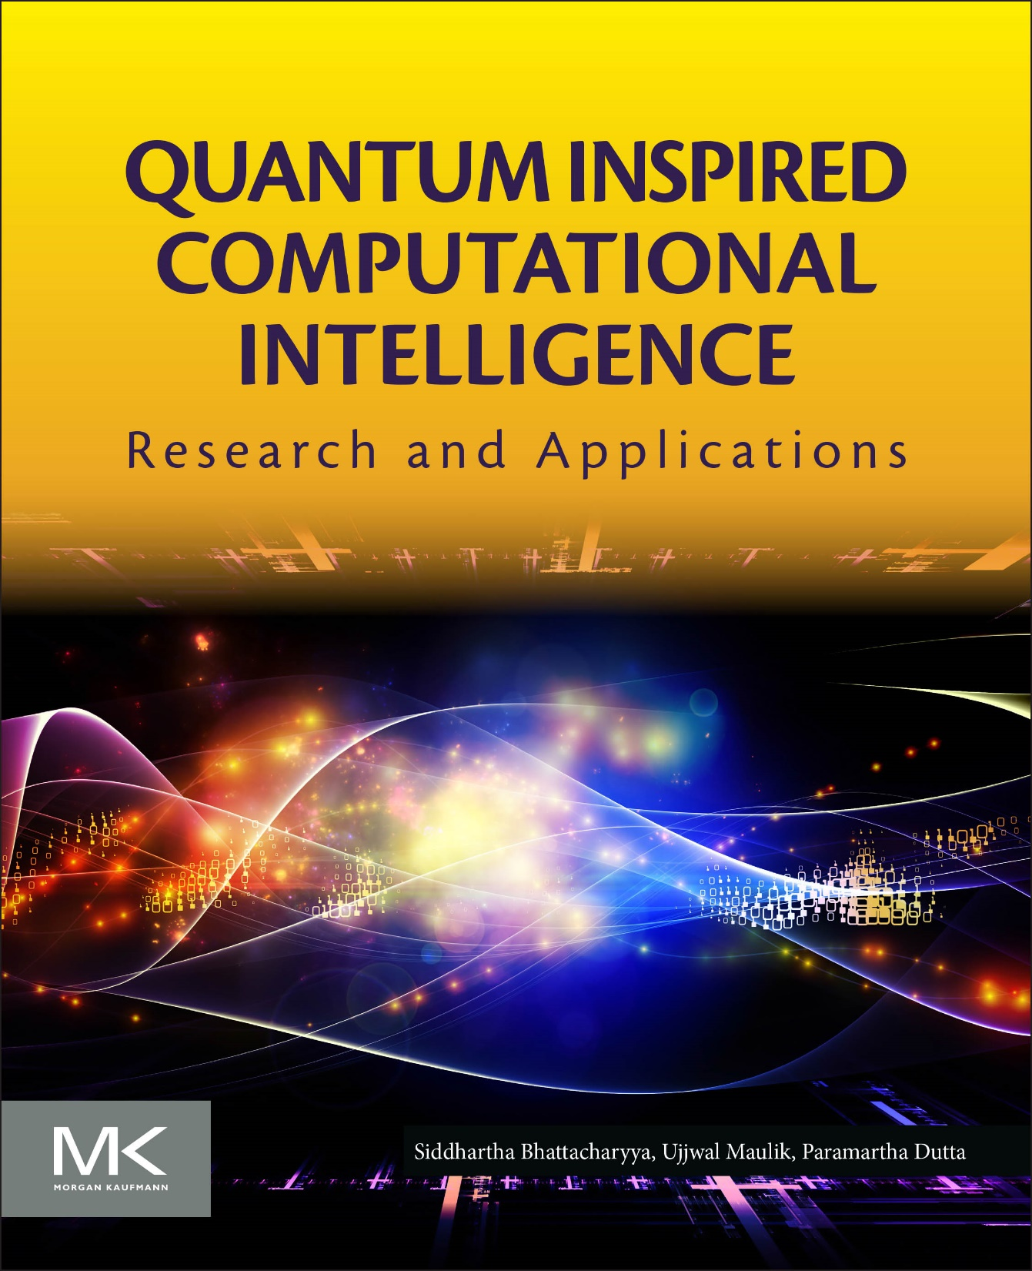
THANK YOU!
4/21/2025
41

